Slide 1
Does Natural Rubber Still Hold Economic Importance?
By : Matt Gill
From the first cry of the new-born babe until the last slow march to the grave, things made of rubber are indispensable to our modern life. -Harvey S. Firestone Jr. September 28, 1931

Slide 2
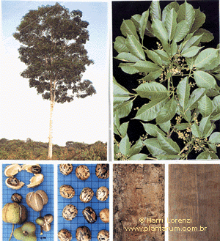
A Story of Hevea brasiliensis
Commonly called the Para Rubber Tree
Naturally they grow up to 145 feet in height in Brazil.
Grows best within 700 miles of the equator.
Cannot tolerate extremes of heat or cold.
Requires abundant rainfall and good soil drainage.

Slide 3
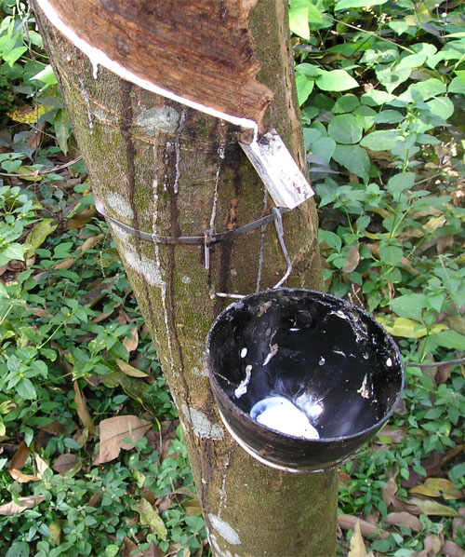
Latex
Rubber is made from the latex that is produced in laticifers of the plant.
There are many plants that produce latex. One worth mentioning is the Gauyule, Parthenium argentatum, which grows in the Chiuahuan Desert of southwestern Texas and nearby in Mexico.
Latex serves the plant as a antiherbivory defense mechanism.

Slide 4
History of Rubber and Its Uses
It is believed that Christopher Columbus found rubber during his second trip to the Americas (1493-1496).
Spanish explorers also found rubber being used by native Indians in Mexico in the year 1521.
The Indians made small bouncing balls that they used in games.
In 1615 it is described in a book by Juan de Torquemada, Monarquia indiana, of natives using the latex of a tree know as Ule to waterproof clothing.

Slide 5
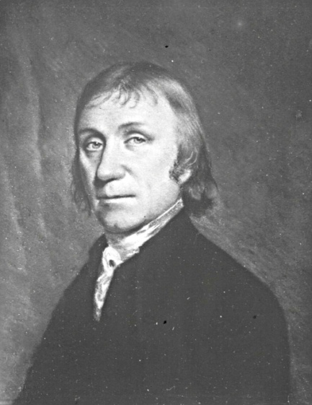
In 1770, Dr. Joseph Priestly, who discovered oxygen, gave rubber it’s name when he noted that it worked well at rubbing pencil marks from paper.
In the year 1823, Charles Mackintosh used rubber dissolved in naptha to coat fabrics and create waterproof jackets. At that time, rubber products would tend to get sticky when hot and brittle when cold.

Slide 6
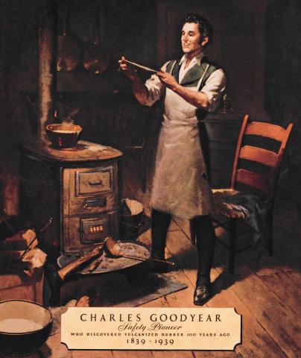
Vulcanisation
In 1839, Charles Goodyear discovered that rubber treated under heat and pressure with sulfur and lead oxide resulted in large improvements of its elasticity, as well as, its ability to withstand changes in temperature.
The process of vulcanization stabilizes the rubber due to the cross-linking of five-carbon isoprene chains.

Slide 7
Rubbers Role in Rolling Tires
The first solid rubber tires are believed to have been developed by a Frenchman as early as 1835. And is noted that Thomas Hancock, with the manufacturing help of Mackintosh, made tires for carriages as early as 1846.
The pneumatic tire was developed in 1845, by Robert William Thompson.
It was not until 1888 that John B. Dunlop developed the inner tube tire for his son’s tricycle. It was only ten years later in 1898 when tires were first being made for automobiles and rapid expansion began.

Slide 8
To Meet the Demand for Rubber
All of the world’s original supply of good rubber grew from the rainforests of Brazil. The Government intended to keep a monopoly on rubber and placed an embargo on plants and seeds.
In 1876, Henry Wickham was successful in smuggling seeds of the rubber tree out of Brazil and back to the Kew Garden in London.
Forty saplings from Kew were taken to Ceylon in southeast Asia to start the first plantation. Presently there are over 8 million hectares devoted to rubber plantations worldwide.

Slide 9
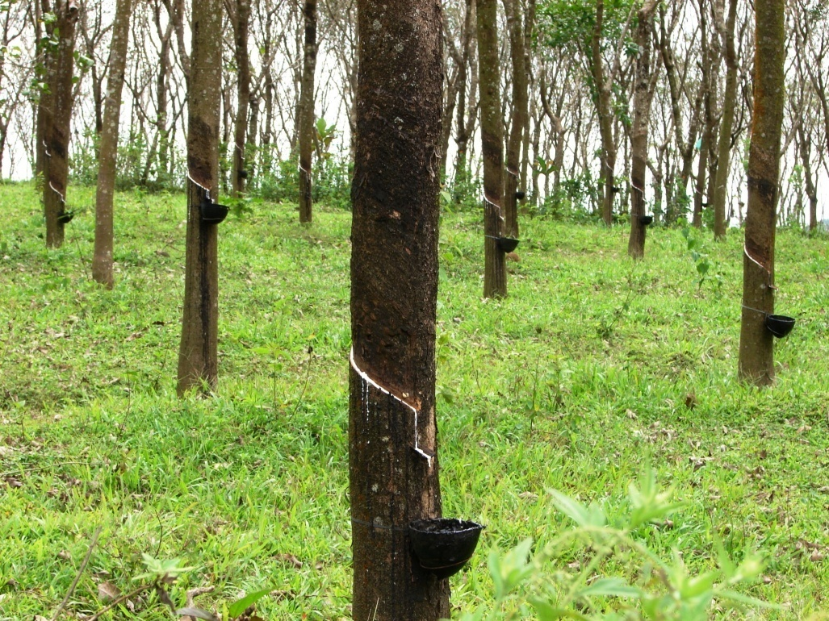
Wild Rubber to Plantation Rubber
Although a rubber tree can grow to 40 meters in the wild. Plantation trees are kept to 25 meters in height.
A rubber tree takes 5 to 10 years to mature before it can be used as a source of latex for rubber.
A rubber tree will live for about 100 years, but plantation trees are replanted every 30 years due to reduction in latex production to an uneconomic level.

Slide 10
Rubber for Tires
Until the invention of tires, rubber did not hold much economical importance.
In 1825, only 30 tons of rubber was exported. By 1900, the exports of wild rubber were at 50,000 tons while plantation rubber was at 4 tons. At that time 60% of rubber was used for tires and it’s components.
Plantation rubber made huge strides in a short amount of time, producing 95,000 tons in 1910.

Slide 11
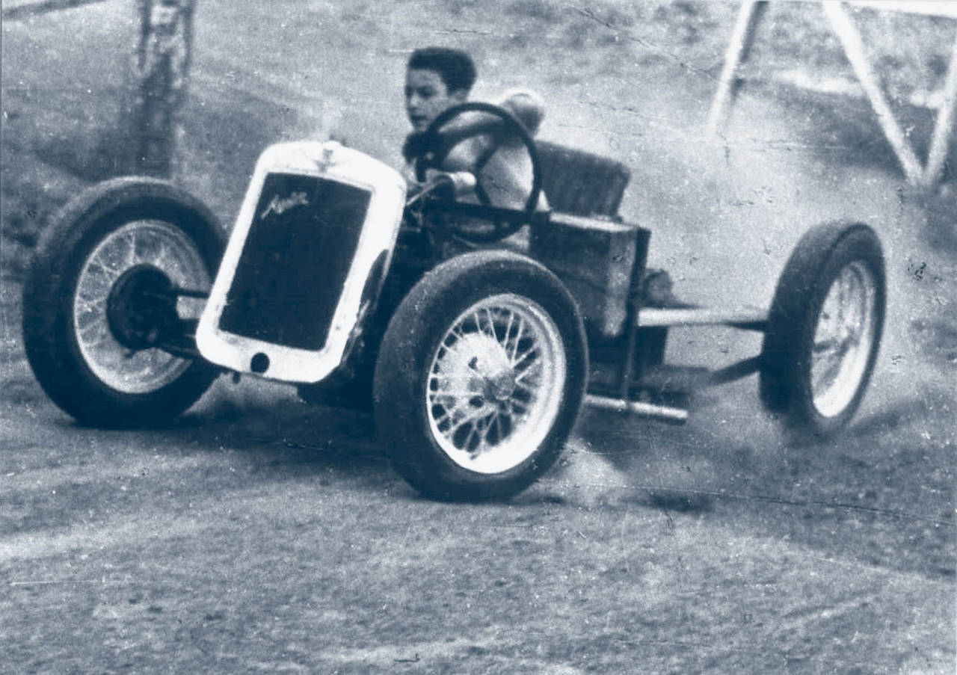
Automobiles Driving the Industry
Due to the rising popularity of vehicles, the demand for rubber was constantly greater than the supply, causing the price of rubber to steadily rise.
After 1911 the amount of plantation rubber increased so rapidly that supply out-numbered demand, causing prices to drop.

Slide 12
Synthetic Rubber
The Germans were the first to produce synthetic rubber in 1914 due to being isolated from every rubber producing country because of World War I.
The rubber they created from dimethylbutadiene, was known as methyl rubber.
After the war, Germany created many types of synthetic rubbers. Production was 5o,000 tons in 1939.
During WWII the U.S. also started creating synthetics, producing 700,000 tons in 1944, due to reduced availability of natural rubber.

Slide 13
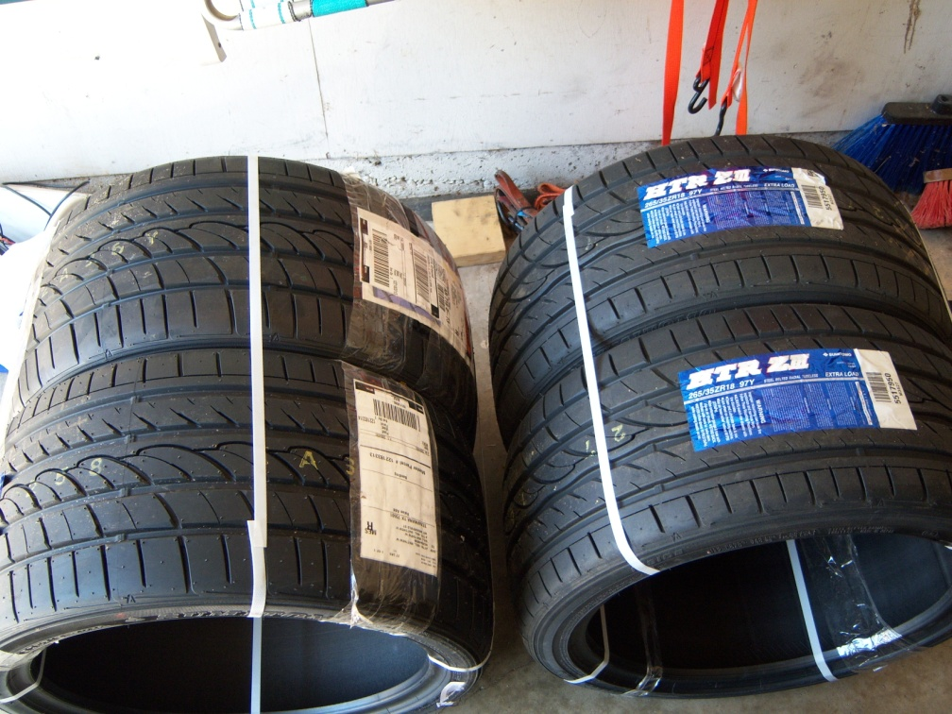
Economic Importance and Stability
Over two thirds of all rubber goes to the production of tires.
Despite the creation of synthetic rubbers. There is still a large demand for natural rubber. On average, 15-30% of a passenger tire is made up of natural rubber. Resulting in a stable market.

Slide 14
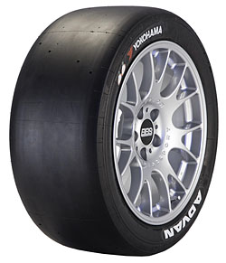
Greener Tires
Racing tires are made primarily from natural rubbers due to higher tear strength and resistance to heat up.
To make tires even more environmentally friendly. Yokohoma has produced a tire made 15% from orange oil and reduces petroleum use by 10%.
Yokohama’s ENV-R1 orange oil tires

Slide 15
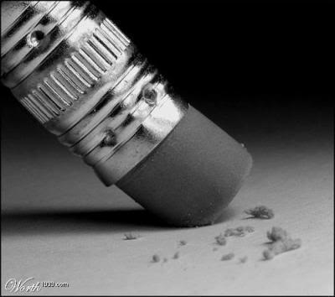
Conclusion
Natural rubber still holds a strong position in the world market. Many items such as surgical and medical examination gloves, condoms, gloves, threads, adhesives, molded foams, footwear, flooring, and numerous industrial applications all account for the natural rubber that is left over from tire production. Natural rubber is not likely to be erased from economical use in the near future.

Slide 16
References
Bras, J. . (1969). Introduction to rubber. New York, NY: Hart Publishing Company, Inc..
Firestone, H.S. Jr. (1936). The Romance and drama of the rubber industry. U.S.A.: Firestone Tire and Rubber Company.
Simpson, B.B., & Ogorzaly, M.C. (2001). Economic botany: plants in our world. New York, NY: McGraw-Hill Companies, Inc..
(2007, June 12). Rubber. Retrieved from http://www.unctad.org/infocomm/anglais/rubber/crop.htm

