Slide 1
Guarana
Is guarana a potential replacement for coffee as a source of caffeine and other drinks or supplements?
Jonathan Kordsmeier

Slide 2
What is guarana?
Guarana (Paullinia cupanais) a shrub found in South American countries, mainly Brazil.
Plant produces a berry containing many chemical compounds including:
Caffeine and Guanine (chemically identical)
Protein, Fat, Starch
Theobromine, Theophylline (cardiac stimulants)
Antioxidants
Introduced to Westerners in the 17th century and Commercialized in 1958

Slide 3
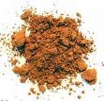
How is it prepared?
The seed is cooked, shelled, and then washed
It is then ground into a fine powder
Can be added to most any liquid
The powder can also be kneaded into
a dough and shaped into bars that can be
mixed into drinks , but is typically added with
sugar because of the somewhat bitter taste

Slide 4
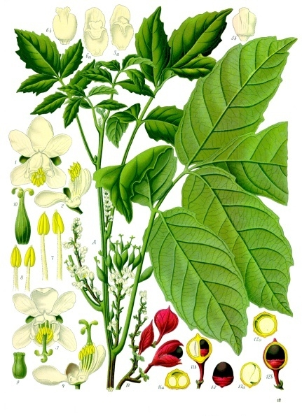
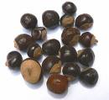
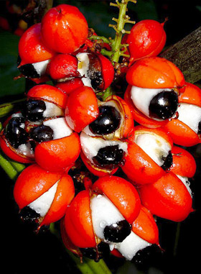

Slide 5
Why is it significant?
Guarana seeds contain 2-3 times the amount of caffeine found within coffee seeds
Can be used as an herbal supplement with many benefits:
Increased energy, cognition, and memory retention
Weight loss supplement
Contains a significant amount of antioxidants
Used as ingredients to drinks and foods, especially within Brazil

Slide 6
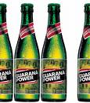
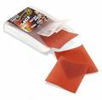
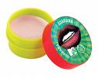

Slide 7
Why is it economically relevant?
Guarana containing drinks exceed sales of cola containing drinks in Brazil
It is used in hundreds of drinks sold commercially within the US including soft-drinks, teas, and energy “shots”
Guarana is sometimes sold as a weight loss supplement that can burn fat as well as increasing energy levels and detoxifying the body
A seemingly cure-all supplement

Slide 8
What are the disadvantages?
It is only generally recognized as safe(GRAS) within the United States
Due to effects of larger amounts of caffeine excessive consumption of guarana can lead to jitters or even onset seizures in some
Detrimental to people with heart conditions and strongly disapproved for women who are pregnant
Possibility of caffeine overdose
Very few studies have been done to show true benefits or disadvantages of guarana

Slide 9
More disadvantages?!
It is not possible for consumers to accurately estimate how much caffeine they are consuming from guarana
Not recommended to people with heart conditions, diabetes, high blood pressure, epilepsy, anxiety, insomnia
Serious adverse effects such as risk of stroke, hemorrhage, myocardial infarction, and sudden death associated to increased heart rate, blood pressure, and changes in glucose or potassium levels

Slide 10
Is it better or worse?
Most adverse effects of guarana consumption can be seen within high caffeine consumption
Until more studies are completed and more strict regulations are placed on guarana it may not be possible to tell whether one is better or worse
“Everything in moderation”

