Slide 1
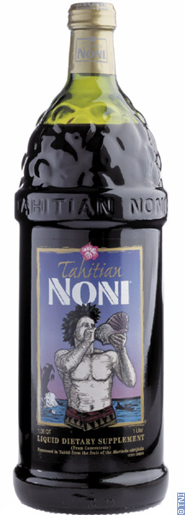
Health miracle or scam?
Tahitian Noni Juice

Slide 2
-Made from the fruit of the Morinda citrifolia tree, a member of the coffee family. -Native to Southeast Asia, it has spread throughout the Indian subcontinent, Pacific Islands, French Polynesia, Costa Rica, Puerto Rico, and the Dom. Republic. -Grown primarily in Tahiti in forests or on open rocky or sandy shores. -Tree reaches maturity in about 18 months and produces 8.8-18lbs of fruit a month year round.
What is Tahitian Noni Juice?

Slide 3
-Two methods are used to make the marketable Noni Juice: 1. 100% Noni Juice is made by picking very very ripe fruit, sometimes even rotten, and allowing the juice to simply drip into out of the fruit. This product has a very bad taste, and is weaker than the second method. 2. The entire fruit is pureed, fermented, and Apple and Blueberry juice is added to cover the bad taste; if too much Apple/Blueberry juice is added the effects will be weakened. The puree must be at least ¾ the mixture.
What is Tahitian Noni Juice?

Slide 4
-Tahitian Noni International (TNI) -TNI will sell you a 33 ounce bottle for $42.00, a 33 day supply. According to TNI you will get: *support for your immune system *a superior antioxidant *aid in digestion *help your hair shine *improved mental clarity, attention span, and greater physical performance levels -There were claims that it would also help treat cancer, with users sometimes reporting complete remission and recovery. -These claims are made based on research done by TNI and hand-picked reports from various sources.
What are the claims being made?

Slide 5
-The fruit’s pulp contains the following macronutrients: 71% Carbohydrates 36% fiber 5.2% protein 1.2% fat -Micronutrients contained in the pulp are: Mainly Vitamin C Niacin Iron Potassium Vitamin A Calcium Sodium Multiple phytochemicals (research on bioactivity didn’t conclude any effects on human health) -The juice of the Noni fruit contains no real nutrients other than Vitamin C, and the level of Vitamin C in Noni pulp is only half of a raw navel orange.
What are you really getting?

Slide 6
-In 2004, the FDA issued a warning letter to a company called Flora. They made twelve unfounded health claims about supposed benefits of noni juice, which caused the juice to be considered a drug. -The FDA said they lacked any scientific evidence the noni phytochemicals have any bioactivity in humans; two similar letters have been issued for the same reasons. -Some brands of noni juice are high in potassium, which can be harmful to persons with advanced kidney disease. -Only 145 medical research papers have been published since 1994; the phytochemical profiles of noni remain poorly related to potential health benefits.
What are you really getting?

Slide 7
http://noni.worldwidewarning.net/index.php -CBS reported, ”Noni Juice: Miracle Or False Hope In A Bottle?” -Salespeople reported Noni healed massive burns, cured dementia caught early, reversed macular degeneration, and even cured an AIDs patient. -Companies can no longer claim that noni cures diseases, and uses the word ‘miracle’ instead. -Labels make claims followed by warnings from the FDA saying they don’t agree.
Warning:

Slide 8
http://cbs2.com/goldstein/Noni.Juice.Tahitian.2.513423.html http://en.wikipedia.org/wiki/Noni http://en.wikipedia.org/wiki/Noni_juice http://noni.worldwidewarning.net/index.php http://www.livescience.com/health/061017_bad_juice.html http://www.nonijuicehealthbenefit.info/noni-juice-production/ http://www.nonijuice.us/benefits-noni.htm
References:

