Slide 1
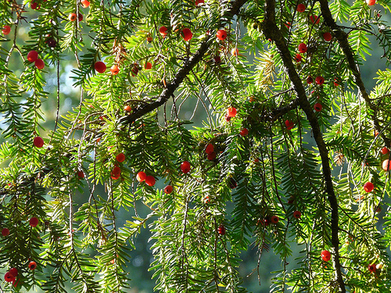
What is the English Yew and how has it developed as an Effective Chemotherapy Agent?
By Amy Evans
Economic Botany

Slide 2
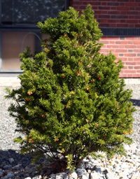
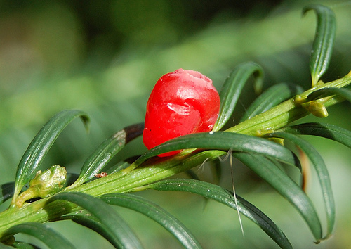
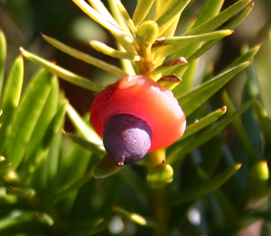
English Yew Taxus baccata l.
Small to medium-sized evergreen tree
Reddish-brown trunk with dark, flat leaves
Every part of plant is poisonous due to Taxine

Slide 3
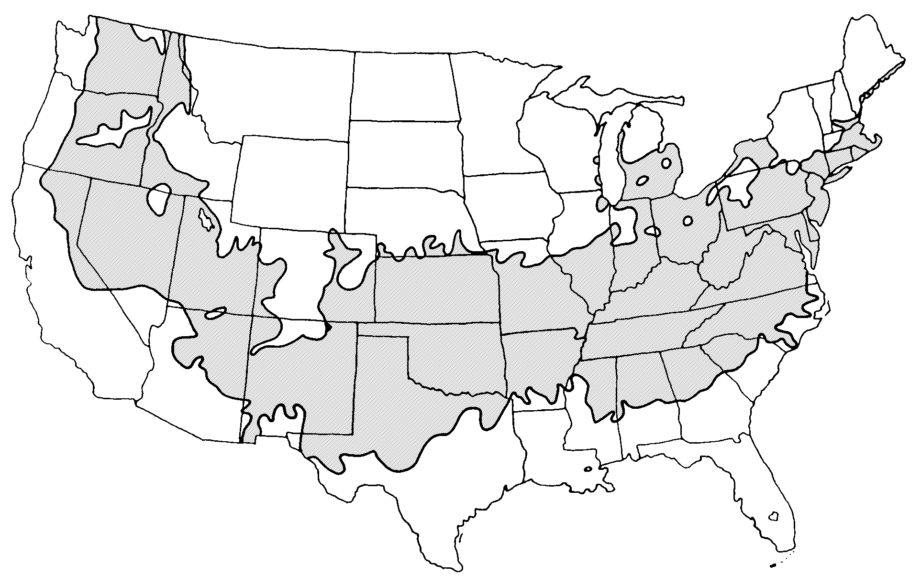
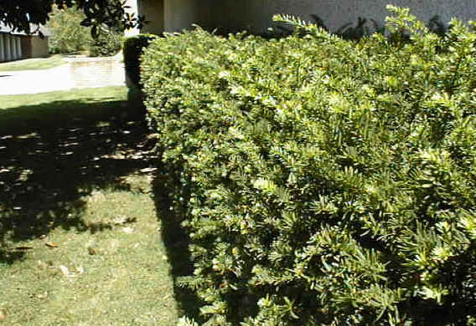
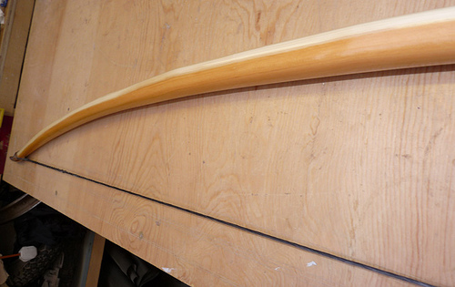
Native to the pacific northwest
Extremely slow-growing
Can live for a very long time
One of the only conifers trimmed regularly into hedges

Slide 4
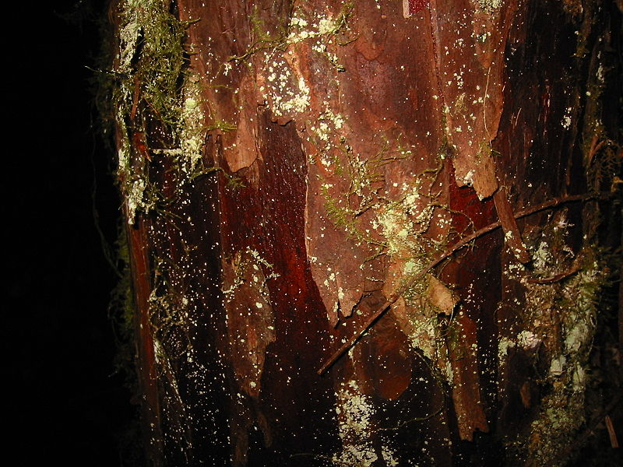
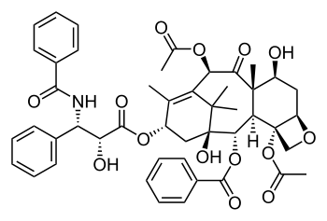
Paclitaxel (Taxol)
Monroe E. Wall and Mansukh C. Wani created the drug from the bark of the English Yew
Mitotic inhibitor
Used in breast, ovarian and lung cancer treatment
Given intravenously (IV)
Annual sales peaked in 2000, reaching $1.6 billion

Slide 5
Side Effects
Low blood counts
Hair loss
Joint and muscle pain (usually resolved within a few days)
Peripheral neuropathy
Nausea/ vomiting (usually mild)
Diarrhea
Mouth sores
Hypersensitivity
*all side effects experienced by more than 30% of the experimental group

Slide 6
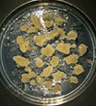
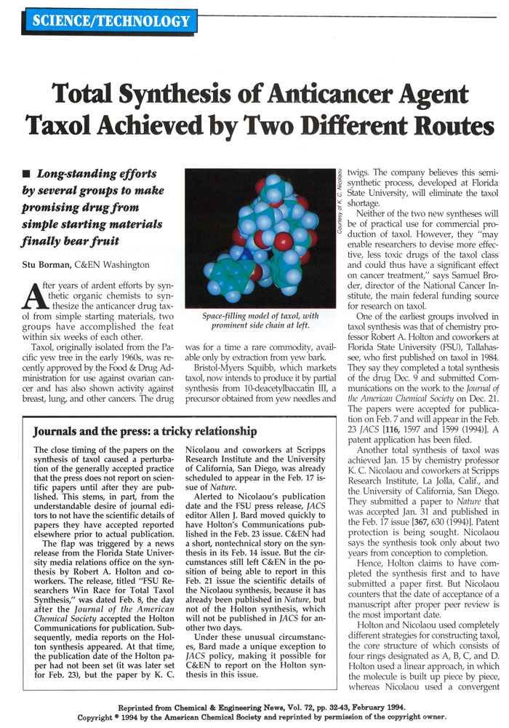
Studies
The first clinical report was issued in May of 1988 showing a 30% success rate in ovarian cancer patients
Paclitaxel Greenness Project by Bristol-Myers Squibb
Princeton- Ovarian Cancer
Vascular Research Center- Lung
cancer (preliminary)
Oxford Journal Study- Head/neck
cancer

Slide 7
References
http://www.britannica.com/EBchecked/topic/188318/English-yew
http://www.chemocare.com/bio/paclitaxel.asp
http://pubs.acs.org/cen/coverstory/8228/8228greenchemistry.html
Princeston Study
http://www2.prnewswire.com/cgi-bin/stories.pl?ACCT=104&STORY=/www/story/07-10-2000/0001261714&EDATE=
Vascular Research Center
http://www.vascularweb.org/professionals/Research/Basic_Articles/Neointimal_hyperplasia_clowes.html
Oxford Journal
http://jjco.oxfordjournals.org/cgi/content/full/34/9/499

