Slide 1
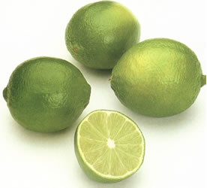
Is lime effective against microbial activity?
By Luisa Escobar

Slide 2
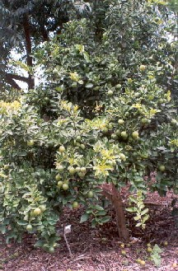
General Information
Family: Rutaceae
Genus :Citrus Aurantifolia (Mexican Lime)
Many species are known.
Native to Himalayan region of India.
Small deciduous tree. Flowers appear in spring and summer.
Fruit from warm regions.

Slide 3
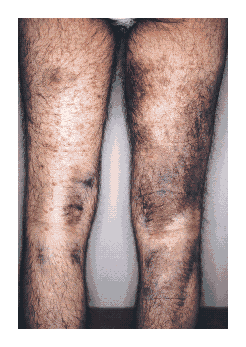
Some History
China, India. Used as poison antidote and to prevent epidemics.
Used to keep bad spirits away,for good luck, and as a tranquilizer.
Used by Greeks as perfume.
18th century. James Lind found lime effective for treatment of scurvy.
Brought by Europeans to the New World due to its properties to cure scurvy.

Slide 4
Uses
Medicinal purposes :
  Helps blood circulation and hemorrhoids.
  kidney stones, minor fevers and bronchial congestion.
  Decrease cholesterol (lignin found in seeds)
  The lemon peel has stomachic properties.
  Cures scurvy
  Insect repellent
  Facial astringent
  Lose weight
  Headaches
  Insect bites
  cleans and treats cuts and minor wounds
  used against constipation and diarrhea.

Slide 5
Culinary uses
  Ingredient for limeade, salad dressings and marinades.
  The juice is used in making cheese, and the pectin contained in the lemon’s peel helps to set jams and jellies.
  Food additive, citric acid helps flavor and acts as a conservative in food and soft drinks.

Slide 6
Other uses
Shampoo, detergents, soaps.
Peel used for cosmetics.
Insecticides.
Perfumes and aromatic products.
To treat stress.

Slide 7
Top Ten Lemons and Limes Producers 2007
COUNTRY PRODUCTION (tonnes)
1.India 2060000
2.Mexico 1880000
3.Argentina 1260000
4.Brazil 1060000
5.Spain 880000
6.China 745100
7.USA 722000
8.Turkey 706652

Slide 8
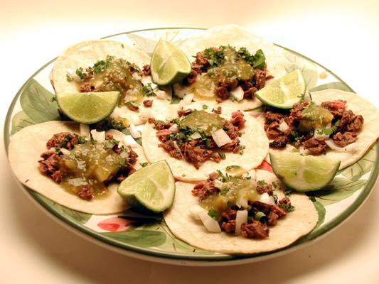
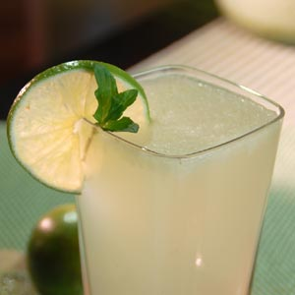
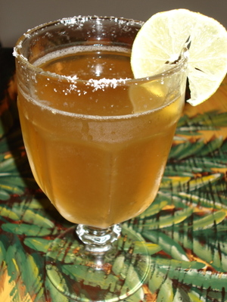
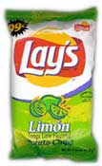
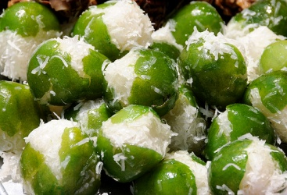
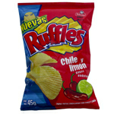
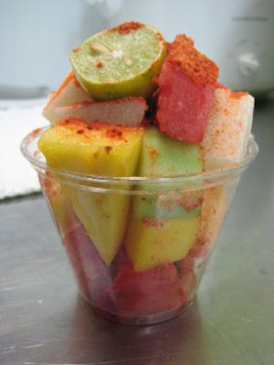

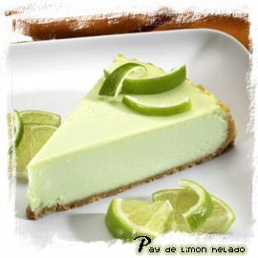
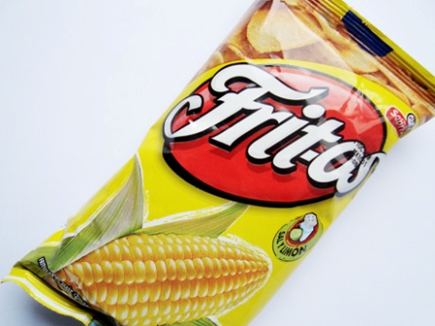

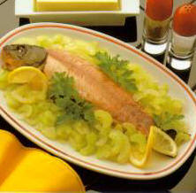
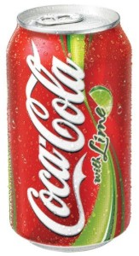
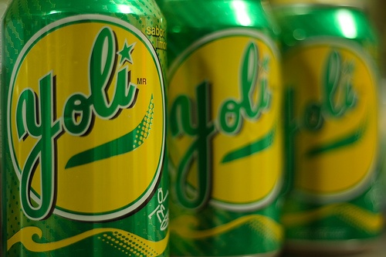
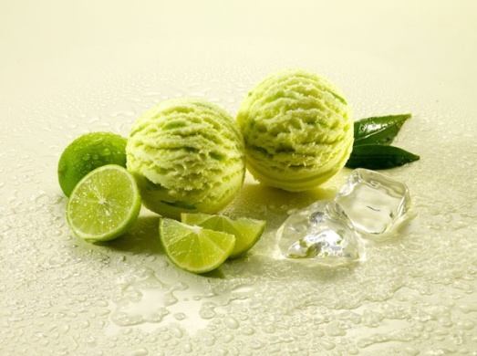
Mexican uses

Slide 9
Antimicrobial activity
21 plant essential oils treated against six bacterial species: Escherichia coli, Klebsiella pneumoniae, Pseudomonas aeruginosa, Proteus vulgaris ,Bacillus subtilis and Staphylococcus aureus at four different concentrations (1:1, 1:5, 1:10 and 1:20).
Cinnamon, clove, geranium, lemon, lime, orange and rosemary oils exhibited significant inhibitory effect. Cinnamon, clove and lime oils were found to be inhibiting both gram-positive and gram-negative bacteria..

Slide 10
More experiments
Lemon and lime were tested for antibacterial activity against seven strains of Vibrio species. All juices were effective in inhibiting the growth of the Vibrio strains. Citric acid, the major organic acid in these juices, was found to be responsible for inhibiting the growth of Vibrio parahaemolyticus.

Slide 11
Effective against microbial activity?
Germicidal effectiveness was found against Candida albicans, 85.77% and against Escherichia coli, 91.447% suggesting seed extracts could be used as an ingredient in germicidal products.
The seed contained 21% protein, 39% vegetable oil and 29% fiber, particularly lignin. The seed could potentially be used as a basic component for nutritional supplements or functional food products..

Slide 12
Chemical components
Flavonoids: Rutin ,Quercetin, Hesperidin, Tangeritin, Lutein, Beta-carotene. Antioxidants and antimicrobial activity.
Ascorbic acid (Vitamin C)- Disinfectant, Boost immune system, antioxidant.
Citric acid -preservative, cleaning agent
Caffeic acid- anti-inflammatory, antioxidant.
Malic and formic acid.
Caffeine (Leaves). Alkaloids, insecticide.
Potassium and Calcium.
Pectin- Bind cells together
Limonene, Bergapten, Camphene, Linalool. Antibacterial. Aromatic. Insecticide.

Slide 13
Conclusions
Due to its high content in flavonoids, acids (ascorbic and citric) and certain hydrocarbons, lime is effective against certain types of bacteria.
Pericarp/peel contains great amount of chemicals that act as antibacterial.
It can indirectly act as antimicrobial by boosting the immune system (ascorbic acid)

Slide 14
References
http://www.scielo.cl/scielo.php?pid=S0718-07642006000600015&script=sci_arttext
In vitro antibacterial activity of some plant essential oils. By: Prabuseenivasan S, Jayakumar M, Ignacimuthu S, BMC Complementary And Alternative Medicine, 1472-6882, 2006, Vol. 6
http://www.newworldnaturals.org/docs/ND%20April%20Article.pdf
Antibacterial activity of citrus fruit juices against Vibrio species. By: Tomotake H, Koga T, Yamato M, Kassu A, Ota F, Journal Of Nutritional Science And Vitaminology, 0301-4800, 2006 Apr, Vol. 52, Issue 2
Food And Agricultural Organization of United Nations: Economic And Social Department: The Statistical Division
http://www.ageless.co.za/herb-lemon.htm#Botanical%20Classification
http://www.botanical.com/botanical/mgmh/l/limfru27.html

