Slide 1
Cryptography Trivia
Week three!

Slide 2
The Game
8 groups of 2
6 rounds
Ancient cryptosystems
Newer cryptosystems
Modern cryptosystems
Encryption and decryptions
Math
Security and Performance
10 questions per round
Each question is worth 1 point
Bonus Bingo: Fill in 25 things from this class that you think are important. Mark them off if or when they come up.

Slide 3
Ancient cryptosystems
This cryptosystem has the encryption function $e_{a,b}\left(x\right)=ax+b$.
This cryptosystem has the encryption function $E_{K}\left(\vec{x}\right)=K\vec{x}$.
Name two ancient cryptosystems that are resistant to frequency analysis.
What is the term used to designate that a cryptosystem encrypts several characters simultaneously?
What is the term used to designate that a key changes throughout the message encrypted?

Slide 4
Ancient cryptosystems
This cryptosystem has the encryption function $e_{k_{i}}\left(x\right)=x+k_{i}$, but changes the key based on the previous plaintext.
This cryptosystem is unbreakable.
In the above cryptosystem over $ℤ_{2}$, how many possible keys are there for a 1024-bit message.
This cryptosystem requires exactly 7 known plaintext-ciphertext pairs to break.
This cryptosystem’s encryption function cannot be described by a “nice” mathematical equation.

Slide 5
Newer cryptosystems
This was the primary cryptosystem used by the Germans during World War II.
What was an advantage of the above cryptosystem?
What was a disadvantage of the above cryptosystem?
This was a cryptosystem used by the Americans during World War II that was never broken.
What was an advantage of the above cryptosystem?
What was a disadvantage of the above cryptosystem?

Slide 6
Newer cryptosystems
What cryptosystem was the first major cryptosystem to place its security just in the key?
This was the first algorithm released to the public that could enable Alice and Bob to establish cryptographic communication?
What algorithm relies on factoring for security?
What algorithm relies on the discrete logarithm problem for security?

Slide 7
Modern cryptosystems
This can replace RSA today.
This might some day RSA in the future.
This handles the vast majority of cryptography today.
In a war, if one side chooses to encrypt their information with AES, what should the other side choose?
In Quantum teleportation, what is “teleported”?

Slide 8
Modern cryptosystems
Name all public-key systems we have covered.
In Quantum computing, this describes the ability for a qubit to become 1 and 0 at the same time.
In Quantum computing, if two entangled qubits both have the value 0.5, what will they be when you observe them?
Will quantum computers make classical computers obsolete?
A 512 qubit quantum computer exists … why can’t it break 128-bit ECC?

Slide 9
Math
Find $3⋅5^{3}+1$ in $ℤ_{10}$
Find $7^{−1}$ in $ℤ_{100}$
Find $φ\left(8,748,000,000\right)$
Find ${35}^{610}$ mod $101$
Find $2^{77304}$ mod $33$
Find ${\left[\begin{matrix}1 & 5 \\ 0 & 3\end{matrix}\right]}^{−1}$ in $ℤ_{10}$.
Find $\left[\begin{matrix}1 & 4 & 3 \\ 0 & 2 & 2 \\ 0 & 0 & 3\end{matrix}\right]\left[\begin{matrix}7 \\ 6 \\ 5\end{matrix}\right]$ in $ℤ_{10}$.
Solve $x^{2}+3x−4=0$in $ℤ_{1997}$.
Solve $4x+y=4$ and $3x−y=6$ in $ℤ_{10}$ simultaneously.
Which is a faster growth rate? $O\left(2^{n}\right)$ or $O\left(n^{2}\right)$?

Slide 10
Encryption!
Encrypt 7 using a rotation cipher over $ℤ_{53}$ with key $k=50$.
Encrypt 18 over $ℤ_{20}$ using an affine cipher with key $\left(7,2\right)$.
Encrypt 3 using RSA with $n=77$ and $b=11$.
Encrypt $"0 0 0 0 0“$ using an autokey cipher with starting key $k=7$ over $ℤ_{10}$.
XOR the string $"01111001"$ with $"0x2b"$.

Slide 11
Decryption!
Decrypt $"0 0 2 4"$, which was encrypted with a vigenere cipher using the key $k=\left(2,4\right)$ over $ℤ_{10}$.
Decrypt $"12“$ which is the output of the accompanying S-box.
Decrypt $"0 0 2 4"$, which was encrypted with a one-time-pad using the key $k=\left(9,9,9,4\right)$over $ℤ_{10}$.
Decrypt $"0 0 2 4"$, which was encrypted using the substitution cipher $\left\{0→1, 1→5, 2→3, 3→2, 4→0, 5→4\right\}$
Solve the discrete log problem $3^{x}≡41$ mod 100.
S | 0 | 1 | 2 | 3
0 | 11 | 12 | 13 | 14
1 | 15 | 16 | 17 | 18
2 | 19 | 20 | 21 | 22

Slide 12
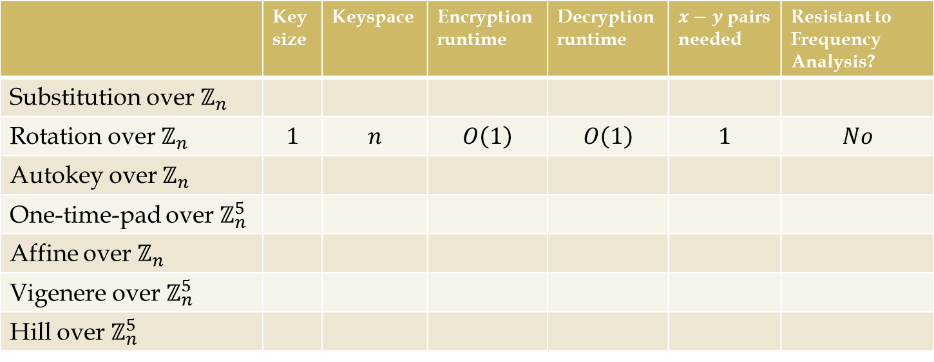
Security and performance
$\frac{1}{3}$ point for the first 9 correct
$\frac{1}{2}$ point for the next 20 correct
1 point for each correct answer beyond 29
(Rotation does not count)
(Assume you only ever store the encryption key and never modify it for quick decryption)
 | Key size | Keyspace | Encryption runtime | Decryption runtime | $x−y$ pairs needed | Resistant to Frequency Analysis?
Substitution over $ℤ_{n}$
Rotation over $ℤ_{n}$ | $$1$$ | $$n$$ | $$O\left(1\right)$$ | $$O\left(1\right)$$ | $$1$$ | $$No$$
Autokey over $ℤ_{n}$
One-time-pad over $ℤ_{n}^{5}$
Affine over $ℤ_{n}$
Vigenere over $ℤ_{n}^{5}$
Hill over $ℤ_{n}^{5}$

Slide 13
Cryptography Trivia
The End

Slide 14
Reference Information
Created in the summer of 2013 by Dr. Jeffrey Beyerl for use in a cryptography class.
This is just a vanilla PowerPoint, but of course like anything you download from the internet: use at your own risk.

