Slide 1


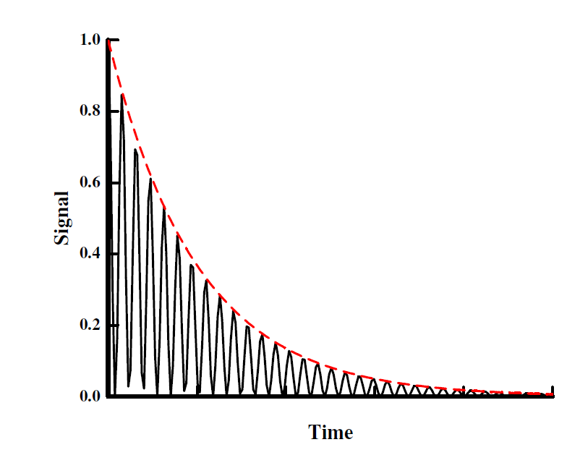
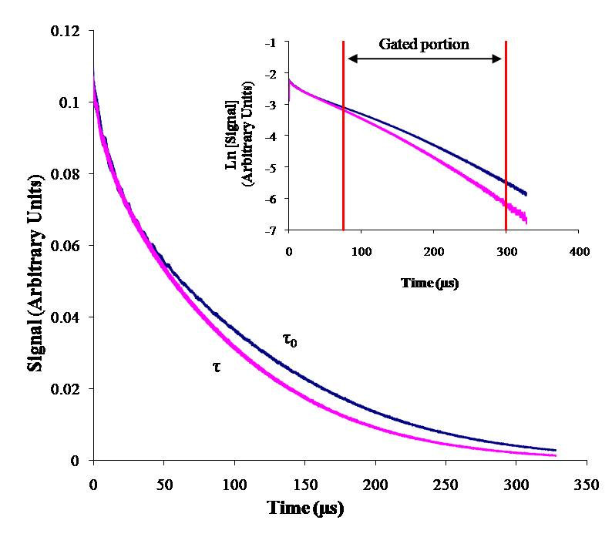
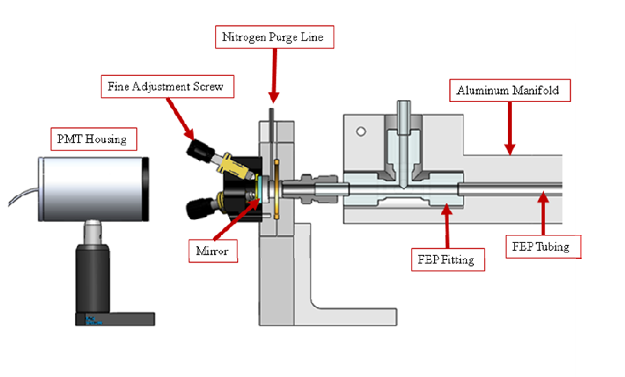

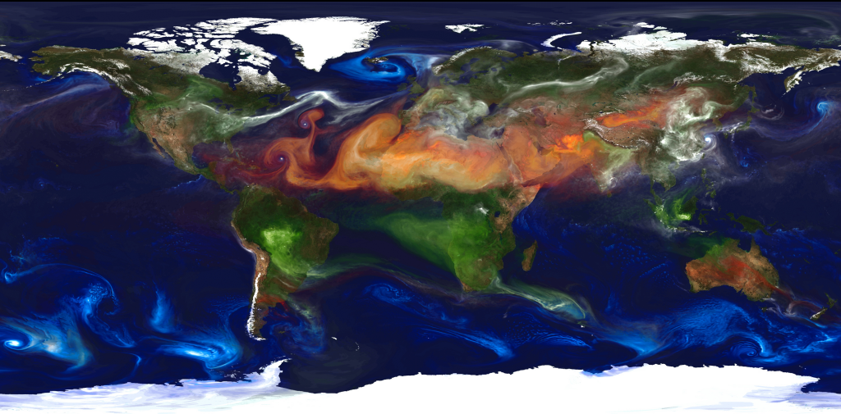


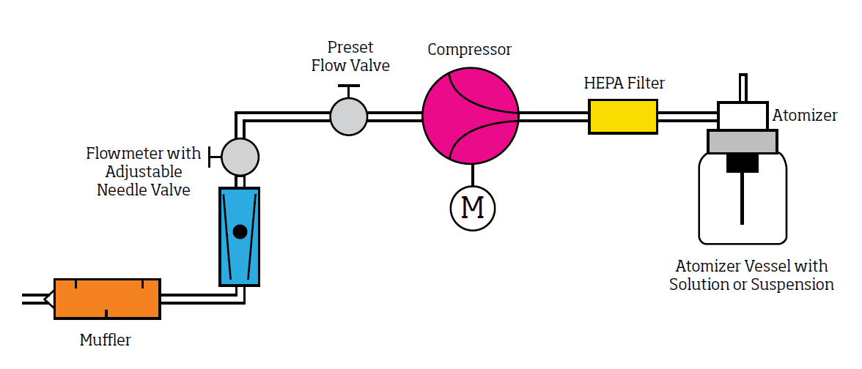

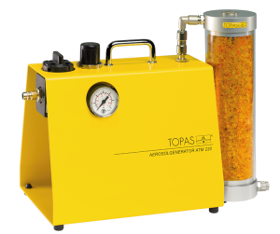
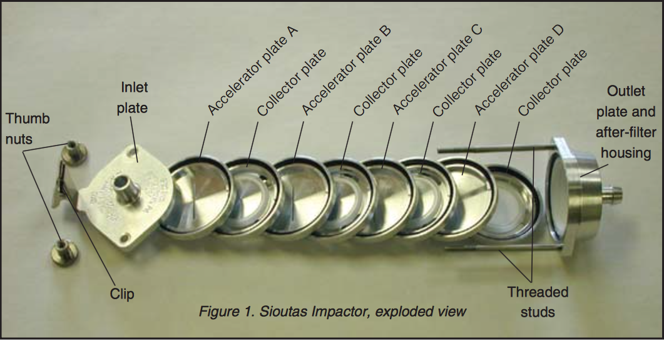
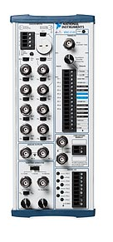

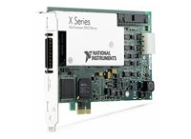


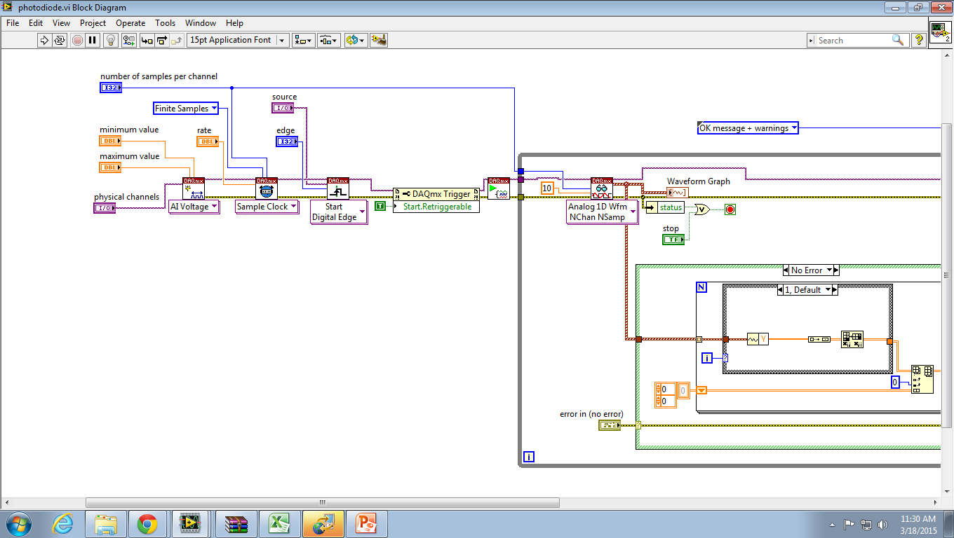
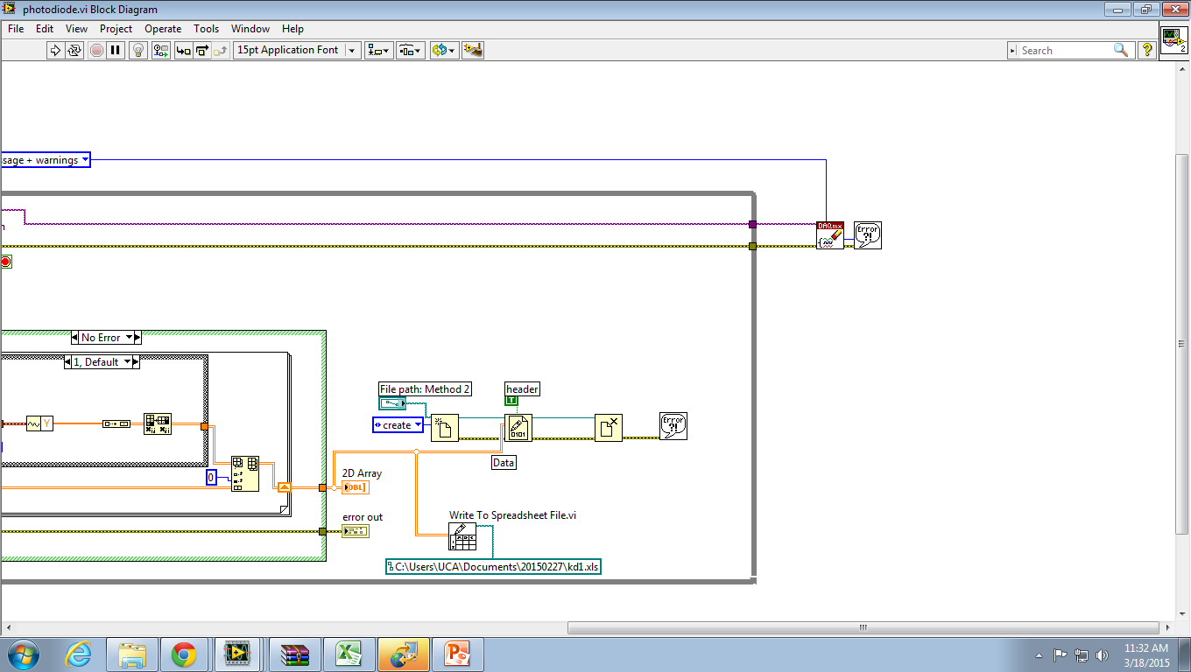
Measurement of aerosol optical properties using pulsed laser cavity ring-down spectroscopy (CRDS).
Logan Bevill, Julio Castillo, and Jay Pittman, and Kristin S. Dooley
Chemistry Department, The University of Central Arkansas, Conway, AR 72035
ABSTRACT
THEORETICAL TREATMENT
Accurate measurements of optical extinction coefficients and scattering parameters for atmospheric aerosols are needed in order to quantify the effects aerosols have on climate change. Although this field was once dominated by Fluorescence FAGE and long-path absorption spectroscopy DOAS, cavity ring-down spectroscopy (CRDS) has emerged as a cost-effective, accurate alternative technique that has numerous advantages. CRDS is an optical absorption technique based on Beer’s Law that allows for the characterization of extremely low concentration target samples by using two highly reflective mirrors to create an optical cavity with a pathlength thousands of times longer than its meter long laboratory footprint. System ring-down information will be monitored and collected using LabView, a program capable of quantifying sensory data and associated ring-down measurements. Well-characterized laboratory generated aerosols of various sizes and compositions will be used to characterize the instrument.
INSTRUMENTATION
Pulsed Cavity Ring-Down Spectroscopy allows for the characterization of aerosol samples through the calculation of the rates of light decay and absorption observed during experimental procedure.
The Beer-Lambert’s Law is expressed by the following equation:
In this equation, α refers to the absorption coefficient (cm^{-1­}) of the sample, c is the speed of light, and R_{L} is the ratio of the cavity length, L, to the length of the cavity where the aerosol is present. 1/τ₀ and 1/τ are the first order decay rate constants, where 1/τ₀ refers to the decay rate constant from the cavity without a sample and 1/τ is the decay rate constant of the cavity with the sample.
Decay rate constants are affected by outside variables that do not pertain to the absorption factor of the target sample and contribute to the loss of light. Therefore, accounting for mirror transmission, light scattering (Rayleigh and Mie) and absorption by species other than the target species allows for an accurate calculation of decay rate and absorption coefficient. Assuming that the cavity is filled with a pure sample, initial decay rate can be found in respect to these variables through the following equation:
Here, T represents mirror transmission, α_{Rayleigh} and α_{Mie} accounts for scattering, and α_{i­} are the absorption coefficients for any species other than the target sample.
Taking the limit of the equation,
allows for the calculation of the minimum detectable absorption coefficient, α_{min}. The minimum absorption coefficient accounts for the integration time necessary to attain certain sensitivity. This calculation is shown in the equation below:
The basic schematic for a typical CRD experiment is shown to the right. CRD spectroscopy is a direct absorption technique based on the measurement of the rate of absorption rather than the magnitude of absorption, so fluctuations in light source intensity do not have an effect on overall detection limits. The CRD spectrometer consists of a gas sample cell with highly reflective mirrors at each end. The mirrors, with reflectivities greater than 99.99%, act as entrance and exit windows for the sample cell.
BACKGROUND
The pulsed laser beam is directed into the sample cell through the back of one of the mirrors. The small amount of light that is trapped inside the optical cavity is reflected repeatedly inside the cavity resulting in an extremely large pathlength. Pathlengths of several kilometers are normal. The small amount of light that escapes the cell through the mirror is detected using a photodetector suited to the wavelength and speed required by the system. The intensity of light leaving the cavity is recorded as a function of time. In an empty cavity, the intensity decay rate is a single exponential function. After a sample is introduced, the change in the decay rate is due to absorption and scattering by the target species.
Cavity ring-down spectroscopy is an extension of an original technique introduced by J.M. Herbelin in the early 1980’s to test the relative reflectivity of high-finesse mirrors in a closed vacuum system. Growing demands for precise atmospheric data led to the development of this technique in its modern form.
CRDS has also been used in numerous instances to look at the scattering and absorption by aerosols, and to measure concentrations of aerosols in field campaigns. Below is a portrait of global aerosols that was produced by a GEOS-5 simulation at a 10-kilometer resolution. Dust (red) is lifted from the surface, sea salt (blue) swirls inside cyclones, smoke (green) rises from fires, and sulfate particles (white) stream from volcanoes and fossil fuel emissions. (NASA)
CURRENT PROGRESS
Aerosol
Generator
Diffusion Drier
Particle Neutralizer
To CRDS Inlet
The Sioutas Multistage impactor (exploded image shown below) will be used to collect particles in the exhaust of the CRDS to aid in discerning the concentration of particles in the CRDS system.
The Impactor is able to separate the collected particles into rough size ranges. Stage A collects particles greater than 2.5 μm, Stage B collects particles 2.5 – 1.0 μm, Stage C collects 1.0- 0.50 μm particles, and Stage D collects 0.50 – 0.25 μm.
Atomizer Aerosol Generator
The Atomizer Aerosol Generator (shown to the left attached to a diffusion drier) will be used as the chief method of generating aerosols for cavity ring-down spectroscopy calibration. The generator produces aerosols by using a built-in compressor to force air through a high-efficiency filter. The contaminant free air then made to create a jet by expanding through the atomizer nozzle. This jet of air then atomizes a solution or suspension into droplets which are suspended in the air flow.
We will use NIST traceable polystyrene spheres in the generator as a method of calibration and instrument characterization.
Natural sources of aerosols include sandstorms, volcanoes, and wildfires while human sources of aerosols mainly consist of the burning of fossil fuels, and changes in land use.
Aerosols play an important role in our earth’s climate. They can be transported from many miles around the globe and are one of the most important factors in climate forcing.
Aerosols are important to characterize and understand for many reasons including their influence on climate change. A main focus of this research is to better characterize the optical properties of aerosols of various compositions and sizes in order to help understand the warming or cooling effect aerosols have on earth’s radiation energy budget.
The amount of radiative forcing due to atmospheric aerosols depends on the type of aerosol and also the characteristics of the earth’s surface below the aerosols.
FUTURE WORK
Current work is centered around setting up the instrumentation and designing a Labview interface that will control the instrumentation.
Begin testing and adjusting the aerosol generation setup using polystyrene spheres as perfectly scattering aerosols. Polystyrene spheres are able to be modeled using Mie scattering, and will allow us to calibrate and characterize the instrumentation.
Begin experiments involving indoor air quality by looking at aerosols produced by candles and other indoor aerosol producers. In a recent study conducted by Li, cavity ring-down spectroscopy was used to calculate ring-down times for smoke, incense smoke, natural gas flame, propane flame, and candle flame emissions. In a published work, Nriagu and coworkers used CRDS to quantify the aerosol characteristics of heavy metals as emitted from metal-core wicks.
We are also working on the Labview interface that will control and record all data collection from the CRDS spectrometer.
Although it has taken time to progress with the Labview programming language, we are now making progress in this area.
We use a NI BNC-2120 for a convenient method of connecting all of our analog and digital signals to an NI PCIe-6361 housed in the computer chassis.
Our program design will record raw data from the spectrometer as well as pressure and temperature readings, and concentration analysis information. All averaged and analyzed data will also be saved and recorded using the program. A portion of the program is shown to the left. The VI shown collects triggered analog signal and converts it to a form that is able to be saved as both a binary file and an excel spreadsheet.
Aerosol and surface combinations that have the largest influence on climate change
Absorbing
aerosol
Scattering
aerosol
ACKNOWLEDGEMENTS
Dr. Simon W. North, Texas A&M
The UCA Department of Chemistry
The UCA College of Natural Science and Mathematics
Low Surface Albedo High Surface Albedo
Notes:
High-resolution global atmospheric modeling run on the Discover supercomputer at the NASA Center for Climate Simulation at Goddard Space Flight Center, Greenbelt, Md., provides a unique tool to study the role of weather in Earth's climate system. The Goddard Earth Observing System Model, Version 5 (GEOS-5) is capable of simulating worldwide weather at resolutions of 10 to 3.5 kilometers (km).

