Slide 1

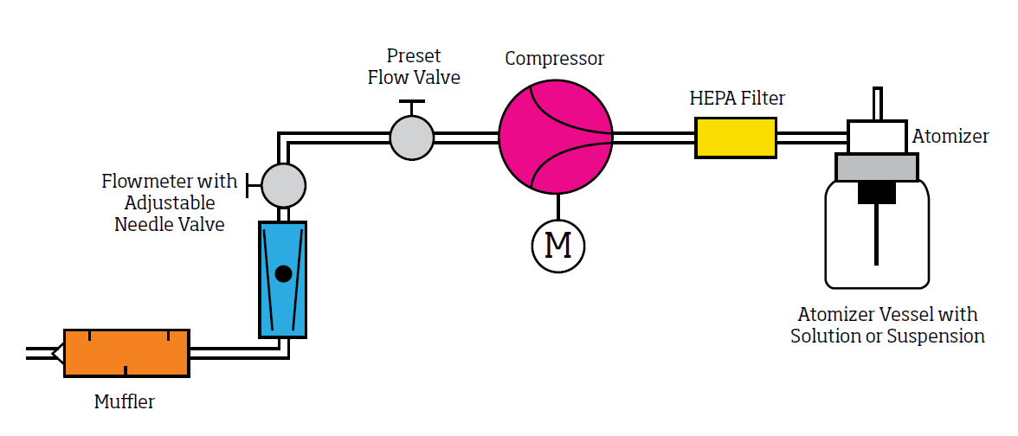
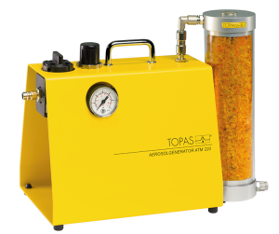
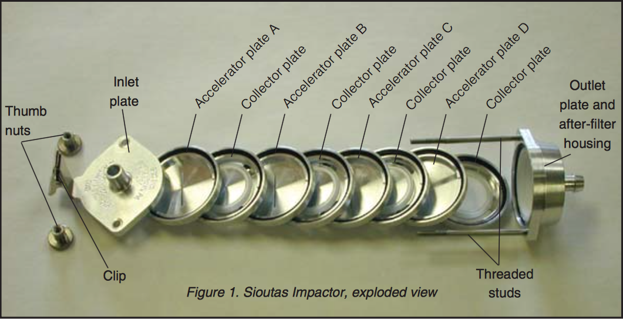
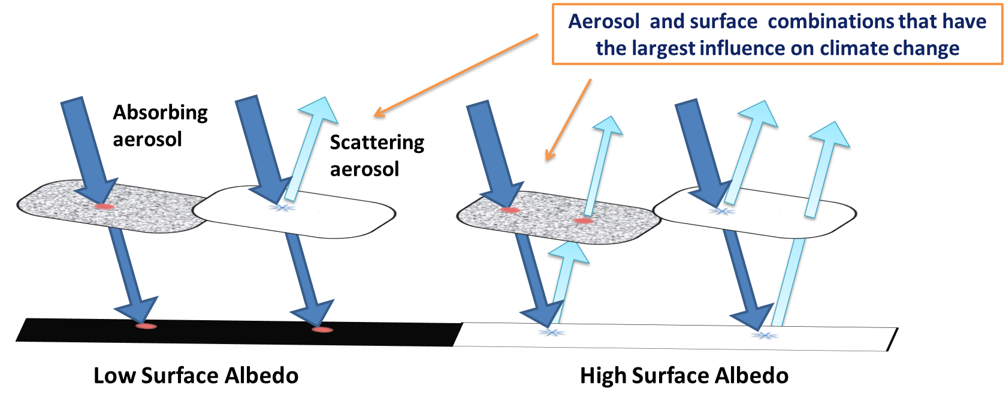
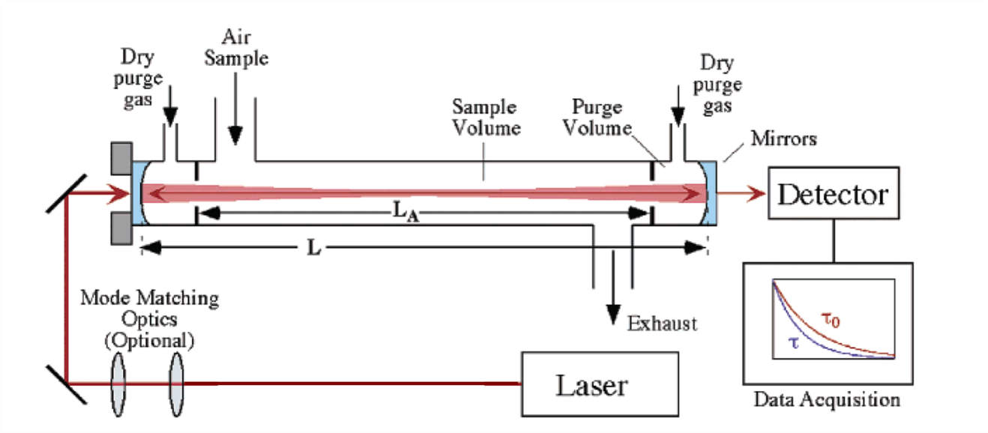
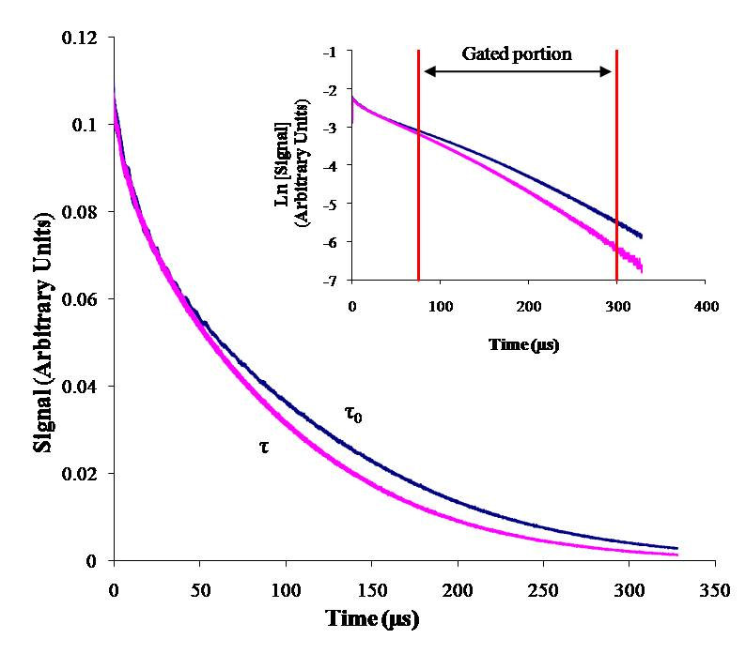
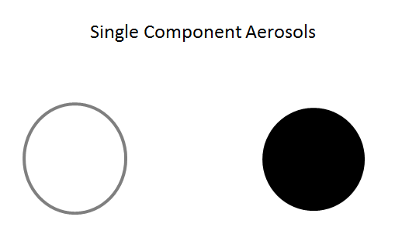
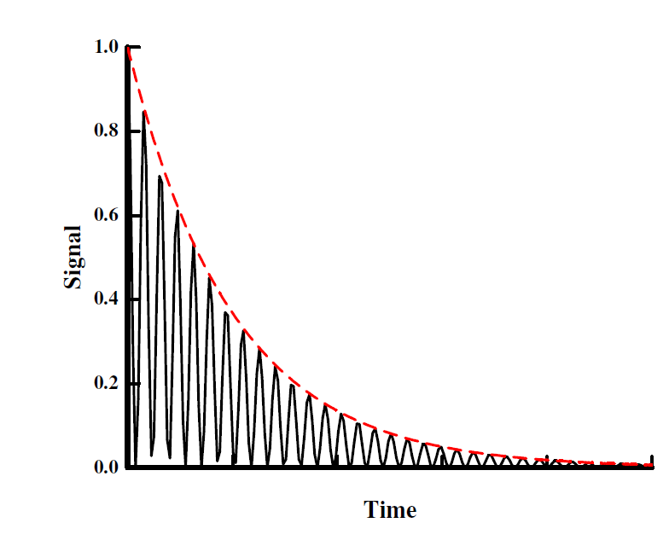
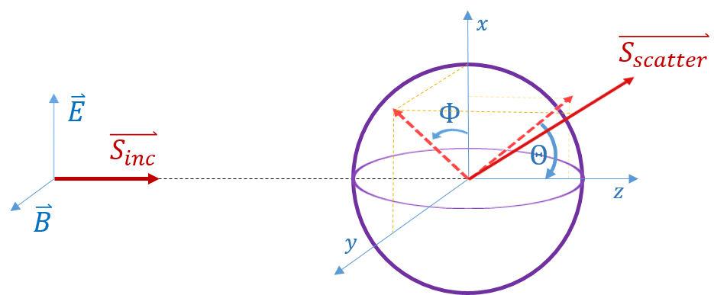
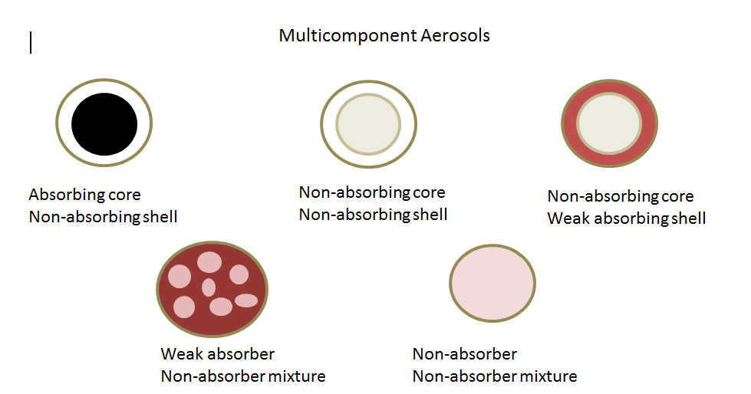
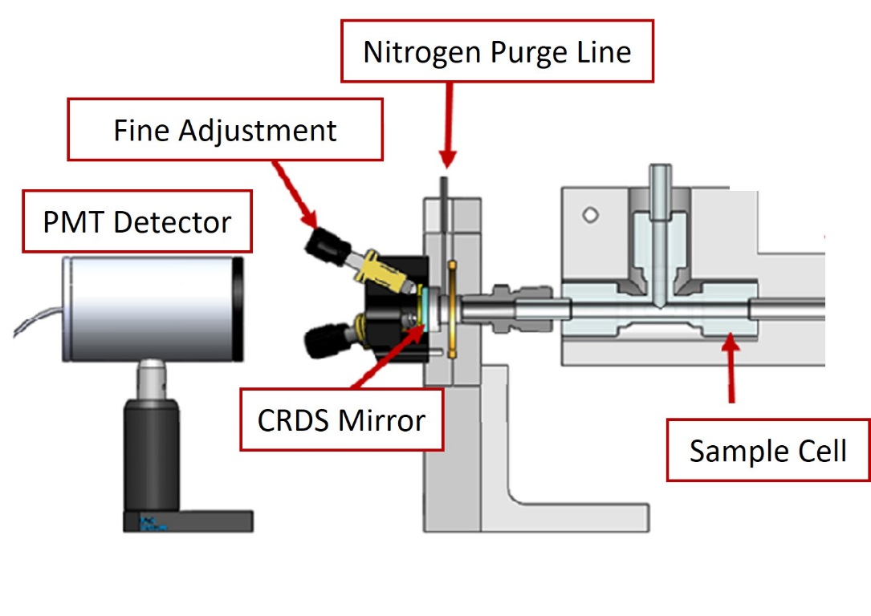
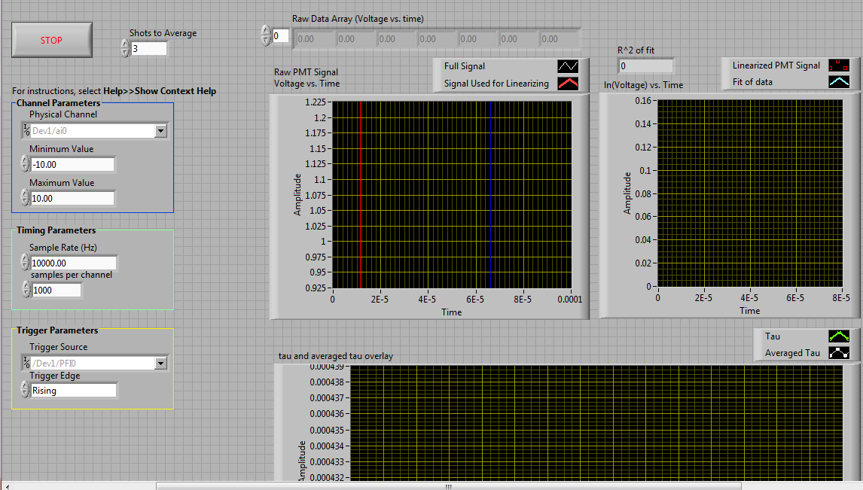


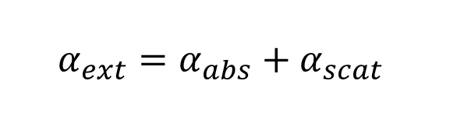


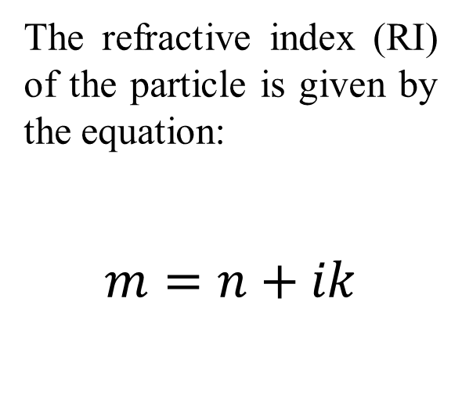
Measurement of multicomponent aerosol optical properties using pulsed laser cavity ring-down spectroscopy
Amanda N. Jarman, Haley E. D. Kay, Jessica DeYoung, Justin A. Land, Kristin S. Dooley
Department of Chemistry, University of Central Arkansas, Conway, AR 72035
ABSTRACT
AEROSOL GENERATION
Single-Component Aerosols
• NIST traceable polystyrene spheres of various sizes and colors
• Particles made from a single water soluble component. Both absorbing and scattering particles can be made by this method, and size can be adjusted through solution concentration.
Aerosol particles in the atmosphere impact the climate through light absorption and scattering processes. Currently, the radiative forcing by aerosols contributes significantly to uncertainty in climate models. More detailed optical measurements of particles of non-uniform size, composition, and chemical structure would aid in reducing this uncertainty. Cavity Ring-Down Spectroscopy (CRDS) is an optical absorption technique that is ideal for measuring extinction coefficients as well as scattering and absorption parameters for atmospheric aerosols. Optical experiments using various sizes of polystyrene spheres at 355 nm and 532 nm will be compared to Mie scattering calculations in order to characterize the CRDS instrumentation. Unfortunately, basic Mie scattering calculations fail when used to model non-uniform samples, and various correction techniques must be included. Multicomponent particles, varying in size and composition, can be produced using current generation techniques and will be used as a comparison to calculated results. Because many atmospheric aerosols are multi-component, a better understanding of how to theoretically treat them will lead to more accurate models of real-world aerosol interaction with light.
Instrumentation
The TOPAS 220 atomizer (Topas, Gmbh) generates polydisperse particles from aqueous solutions
Droplets pass through a diffusion drier which resulting in dry particles
Because this process often produces charged particles, the particle neutralizer (Aerosol Dynamics, Inc) is used to minimize the charge carried by the particles.
Aerosol Droplet BEFORE Drier
Aerosol Droplet AFTER Drier
Particle Characterization
Sioutas Multistage impactor collects exhaust
Determines concentration of particles
Each stage selects for a specific size range
Stage A: >2.5µm
Stage B: 2.5-1.0µm
Stage C: 1.0-0.50µm
Stage D: 0.50-0.25µm
After particles are collected on filters, SEM images will be used to determine shape and size of individual particles.
The neutralizer uses StaticMaster Polonium sources to neutralize the particles.
Particles must be neutralized to ensure that they do not stick to the tubing and walls of the chamber.
Multi-Component Aerosols
• Polystyrene spheres coated with various water soluble components. Both scattering and absorbing shells can be made.
• Homogeneous internally mixed particles will be made from a multicomponent solution. Size is adjusted through overall solution concentration, and component percentages are also variable.
Aerosol
Generator
Diffusion
Drier
Particle Neutralizer
To
CRDS
INTRODUCTION
Aerosols play an important role in our earth’s climate. They can be transported from many miles around the globe and are an important factors in climate forcing.
The amount of influence on climate change due to atmospheric aerosols depends on the type of aerosol and also the characteristics of the earth’s surface below the aerosols.
Generate and Characterize Aerosols
CRDS Instrumentation
Comparison of Measurement to Theory
INSTRUMENTATION
CRDS is an absorption technique based on the rate of absorption, not the magnitude. Because of this, fluctuations in the laser do not effect the concentration measurements.
The extinction coefficient is related to the ring-down times using Beer-Lambert’s Law and is expressed by the following equation:
$$α_{ext}=\frac{R_{L}}{c}\left(\frac{1}{τ}−\frac{1}{τ_{0}}\right)$$
The particle extinction efficiency (Q_{ext}) is defined as:
$$Q_{ext}=\frac{radiant power scattered or absorbed by particle}{radiant power incident on particle}$$
For mono-disperse spherical aerosols, the aerosol extinction coefficient (α_{ext}) is related to the particle extinction efficiency (Q_{ext}) by:
$$Q_{ext}=\frac{α_{ext}}{{πr}^{2}}$$
Q_{ext} is related to the index of refraction of the particle
and can be calculated using Mie Theory.
COMPARISON TO THEORY
The intensity as a function of time measured in an empty cavity is given by:
$$I\left(t\right)=I_{0}exp⁡\left(\frac{−t}{τ_{0}}\right)$$
Linearizing the data allows the ring-down time to be obtained from the slope:
$$\ln\left(I\right)=\frac{−1}{τ_{0}}t+ln⁡(I_{0})$$
When an absorbing (or scattering) sample is present, the value of the adjusted ring-down time can be obtained in a similar manner.
Light scattering occurs when an electromagnetic (EM) wave interacts with a particle by perturbing the electron orbits in the particle’s molecules. The oscillating induced dipole is a source of radiation, resulting in scattered light. Mie Scattering Theory is a general treatment for spherical particles with no size requirement for the particle. This treatment converges to geometric optics for large particles, and to Rayleigh Scattering for small particles, and allows the computation of important optical properties.
.
Aerosol contributions to forcing are based on Mie Scattering calculations based on a simplistic model of spherical aerosols which are termed “black” if they absorb all light without scattering any, or “white” if they only scatter light.
Unfortunately, internally mixed particles are modeled quite poorly. Mathematical corrections have been proposed by Rudich and coworkers (Phys. Chem. Chem. Phys., 12, 21, (2010)) who noted that the best correction method depends on the type of internal mixing.
The refractive index (RI) of the particle is given by the equation:
$$m=n+ik$$
Absorption Component
A main focus of this research is to better characterize the optical properties of aerosols of various compositions and sizes in order to help understand the warming or cooling effect aerosols have on earth’s radiation energy budget.
Coordinate Geometry for Mie Scattering
Scattering Component
$$α_{ext}=α_{abs}+α_{scat}$$
Accurate values of n and k are necessary for using Mie Theory to compute accurate radiative properties of aerosols. A number of methods or “mixing rules” have been developed for computing n and k for internally mixed aerosols which are based on the RI’s of the components. Comparison of the RI determined through mixing rules to experimental RI values is needed to determine which mixing rules are best for describing the various types of internally mixed particles.
The schematic for the CRDS experiment is shown above. Mirrors with reflectivity greater than 99.99% form the ends of the sample cell. The pulsed laser beam (355, 532, or 1064 nm) enters the glass cell through the back of one mirror and is reflected back and forth inside the cell which results in an effective pathlength of several km. The intensity of light that escapes to the detector is recorded as a function of time. Sample air is introduced through the top of the cell with a nitrogen gas purge at the mirrors to keep particles from sticking to the mirrors. A Labview program has been written that collects and analyzes data.
1. Use CRDS to measure Q_{ext} values for various sizes of particle.
AKNOWLEDGEMENTS
2. Using Mie Scattering Theory, determine the best index of refraction values by fitting the data to computed values of Q_{ext}
Dr. Simon W. North, Texas A&M
UCA University Research Council (URC)
NASA Arkansas Space Grant Consortium
3. Compare n and k values to various mixing rules and determine the most appropriate mixing rules for the type of particle.

